Slide 1
Приложение 4 / Appendix 4
MSc Program
Portfolio Sold-Out Problem in Numbers
for DeFi Lending Protocols
Student: Waralak Pariwatphan
Research Advisor: Yury Yanovich
April, 2023
1/xx

Slide 2




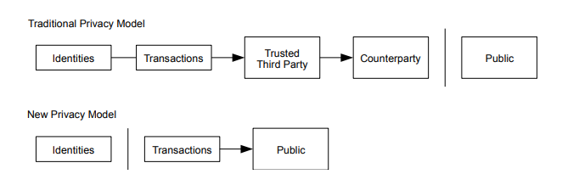
DEFI MEETS CLASSIC FINANCE
decentralized finance: peer-to-peer financial services on public blockchains.
Parameters:
Probability of default (PD)
Loss Given Default (LGD)
Liquidity coverage ratio (LCR)
Bank secrecy.
[Nakamoto, S. (2008). Bitcoin: A Peer-to-Peer Electronic Cash System. Www.Bitcoin.Org, 1–9. https://bitcoin.org/bitcoin.pdf]
The loan mechanism on the Maker protocol

Slide 3
Bank Loan Portfolio Tokenization: Summary
New competitive tools for small investors
Free secondary market
Blockchain needed
Bank loans can be tokenized and regrouped into commodity
Lack of bank auditability by government
Free secondary market

Slide 4

General problem / Introduction /
Background
Blockchain
Lack of audibility
in traditional finance
Lack of audibility
in traditional finance
Split assets for investing
Split assets for investing
Portfolio sold-out problem
for DeFi lending protocols
Notes:
Phrases you may find useful:
The area of my research covers …
Today … has been already studied in the field.

Slide 5
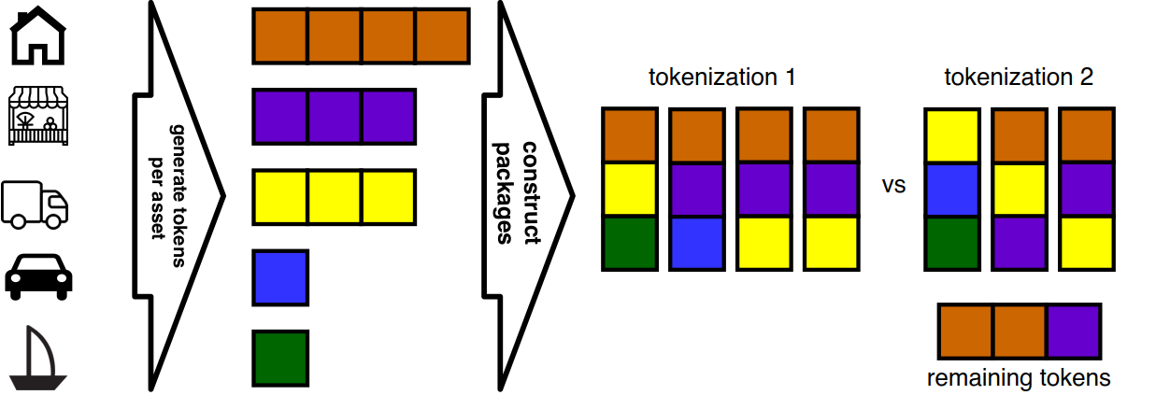
Portfolio Sold-Out: Problem
How to construct as many packages as possible for a given token set?

Slide 6
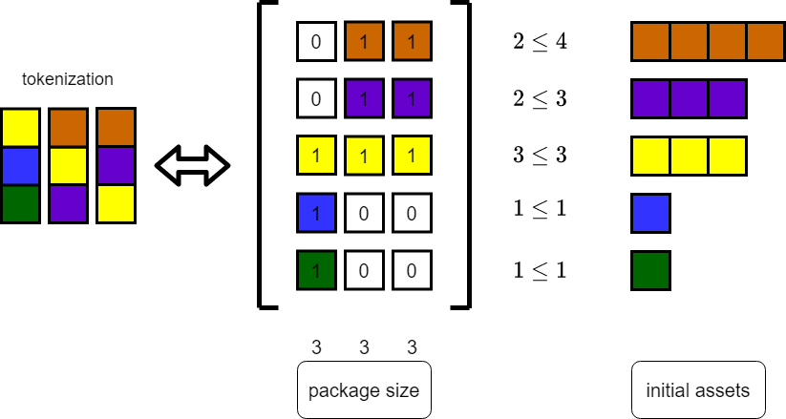
Portfolio Sold-Out: Objective
Find a matrix with the maximum possible number of columns under given restriction.

Slide 7
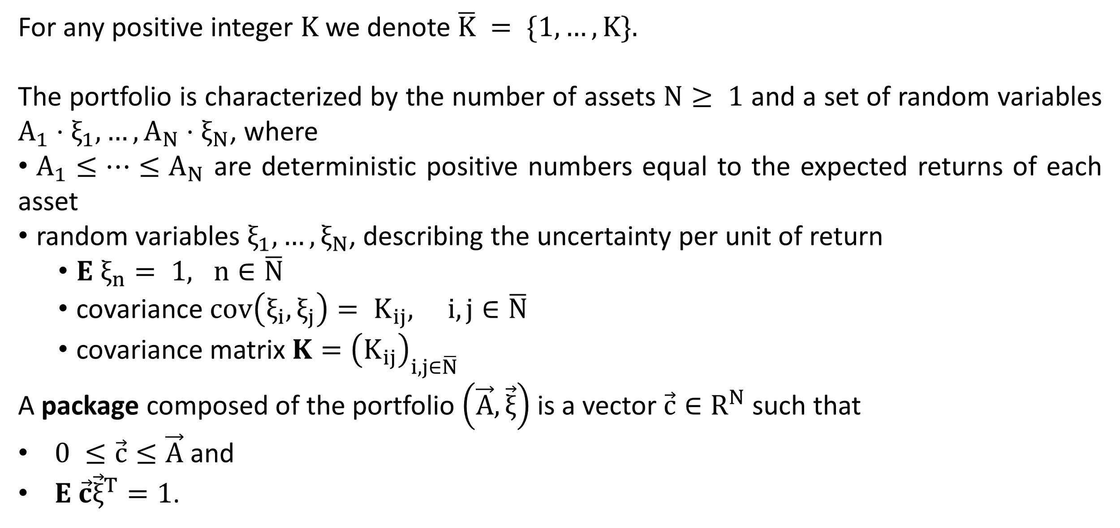
Portfolio Sold-Out Problem: Notations

Slide 8
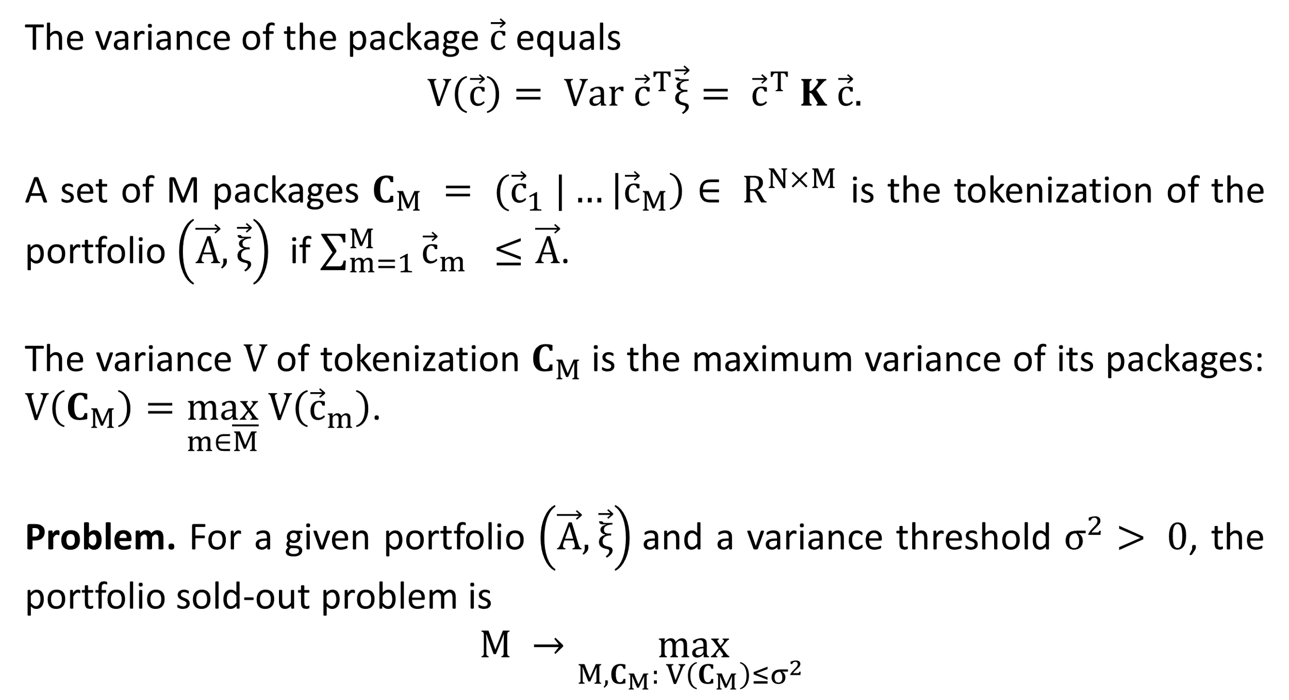
Portfolio Sold-Out Problem

Slide 9
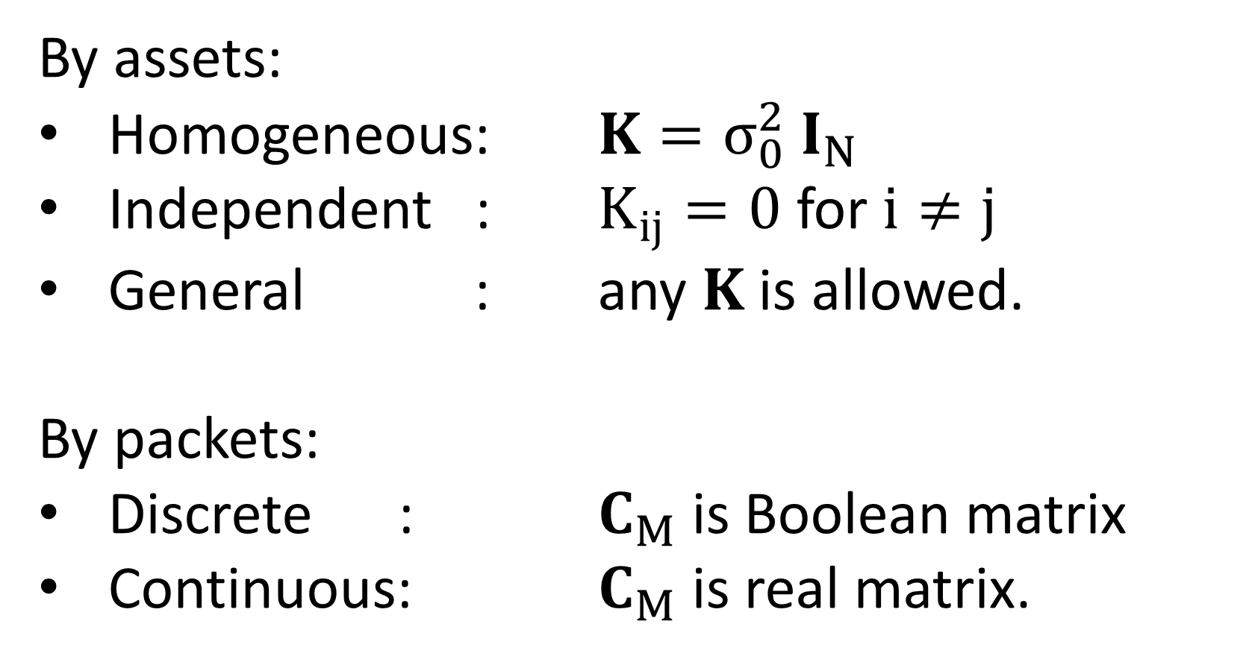
Portfolio Sold-Out Problem: Special Cases
 | Discrete | Continuous
Homogeneous | optimal solution | optimal solution
Independent | to be solved | to be solved
General | to be solved | numerical solution

Slide 10
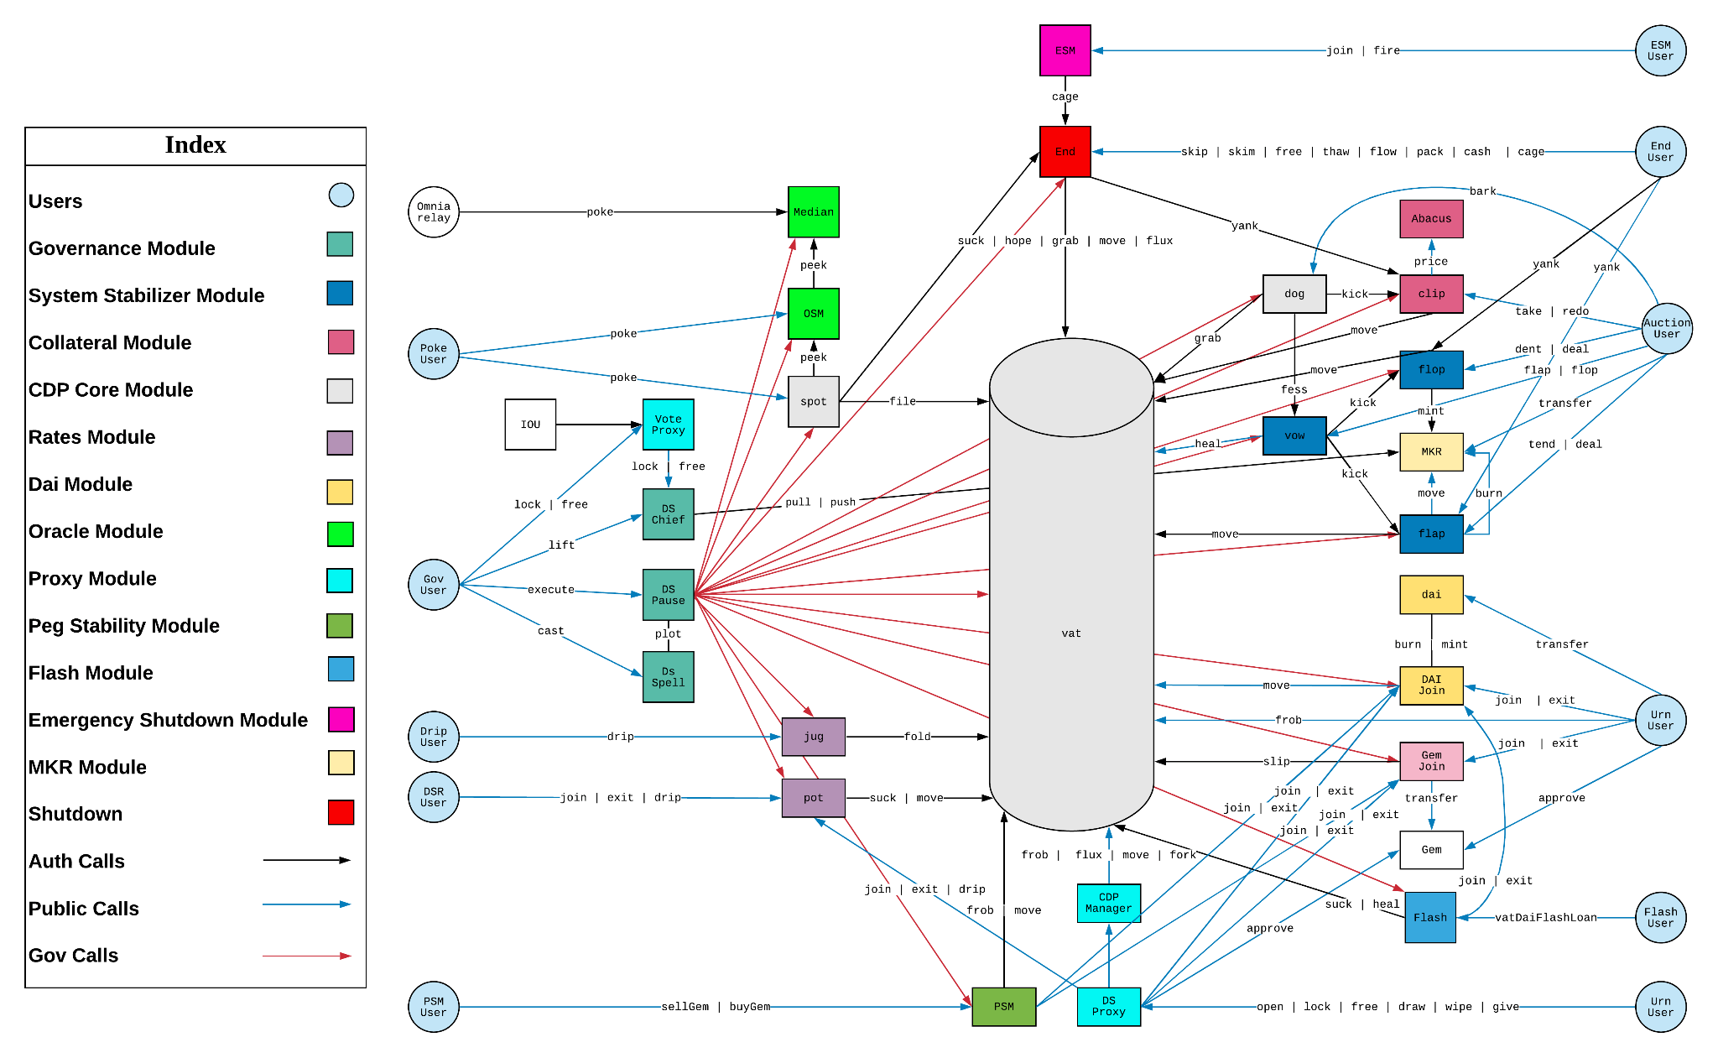
MakerDao
ilk.pip
holds the current price of a given ilk (collateral)
Vat
stores Vaults and tracks all the associated Dai and Collateral balances
Jug
accumulate stability fees for a particular collateral type

Slide 11
Aim and objectives
Design and develop optimization method to obtain the optimal portfolio sold-out
01
Apply optimization method to the MakerDao dataset
02
Notes:
The overall purpose of the work is to …
The objectives of the present research run as follows:
1…
2…
3…
Design and develop optimization method to obtain the optimal portfolio sold-out
2. Apply optimization method to the MakerDao dataset

Slide 12
Methods
Reduce portfolio sold-out to Second-Order Cone Program (SOCP)
Prepare MakerDao dataset for tokenization
Apply SOCP solver to portfolio sold-out problem

Slide 13
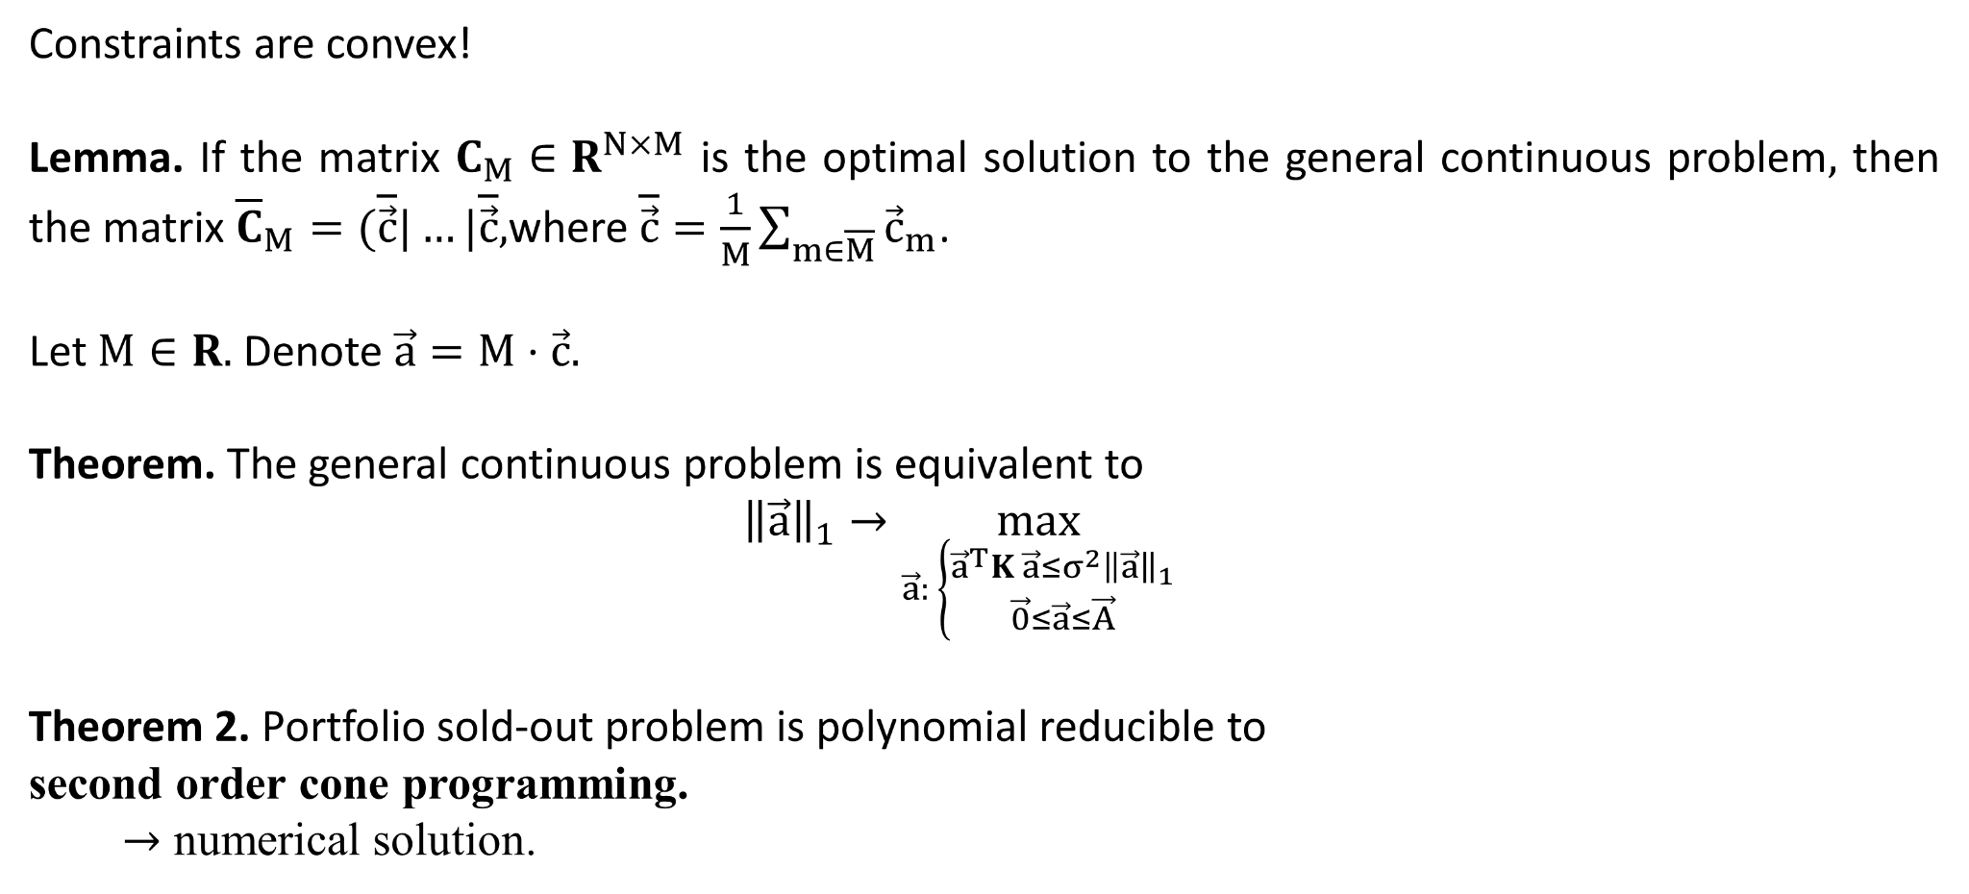
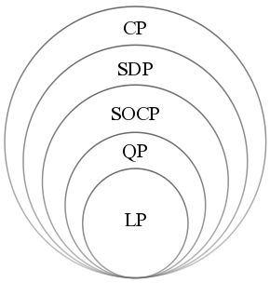
General Continuous
LP: linear program, QP: quadratic program, SOCP second-order cone program, SDP: semidefinite program, CP: cone program.

Slide 14
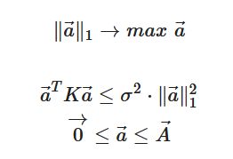
Methods: Portfolio sold-out
a : summation of investment proportion set
A : expected returns of each asset
K : covariance matrix of assets

Slide 15
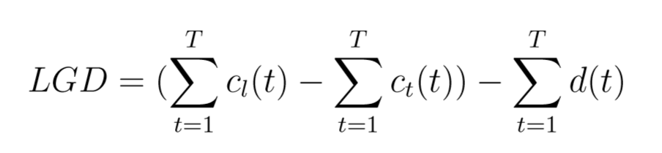
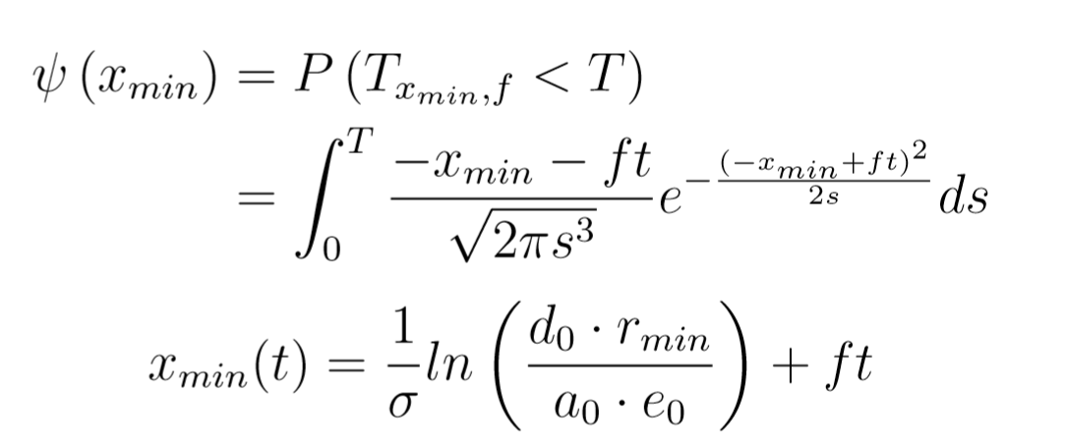

Methods: Economic Statistics
Loss Given Default (LGD)
c_{l} is locked collateral, c_{t} is transferred collateral,
d is issued debt
Probability of Default (PD)
Interest Rate
cumulative rate R at time T

Slide 16
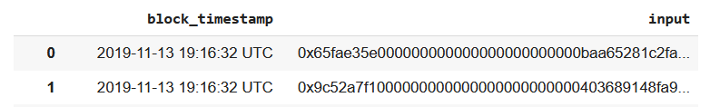
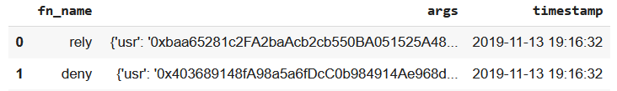
Results: Decoding Data
Raw data
web3 to decode input
(using contract address and API
of Vat contract)
Decoded data
Function name : frob
Timestamp : 2019-11-13 22:10:04
Arguments :
i : ETH-A
u : 0xDB47695103dc0a2645A25B8F11EA0a5c03FE52E8
v : 0xDB47695103dc0a2645A25B8F11EA0a5c03FE52E8
w : 0xDB47695103dc0a2645A25B8F11EA0a5c03FE52E8
dink (change in collateral) : 50000000000000000 (0.05 ETH)
dart (change in debt) : 0
Vaults are handled via the frob protocol, which modifies user u's Vault by utilizing collateral tokens from user v and creating DAI for user w.

Slide 17
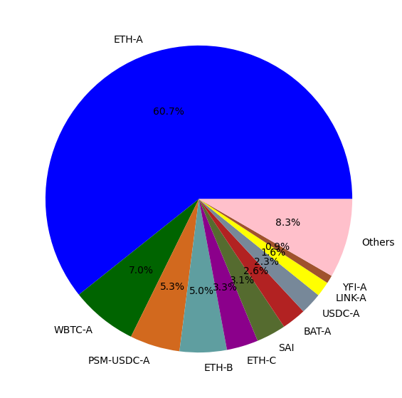
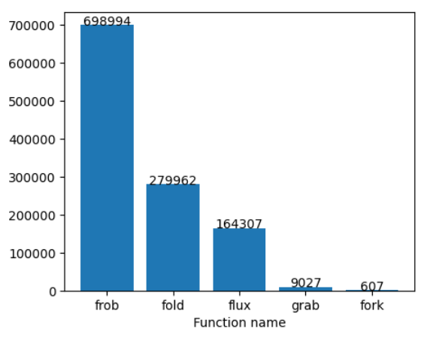
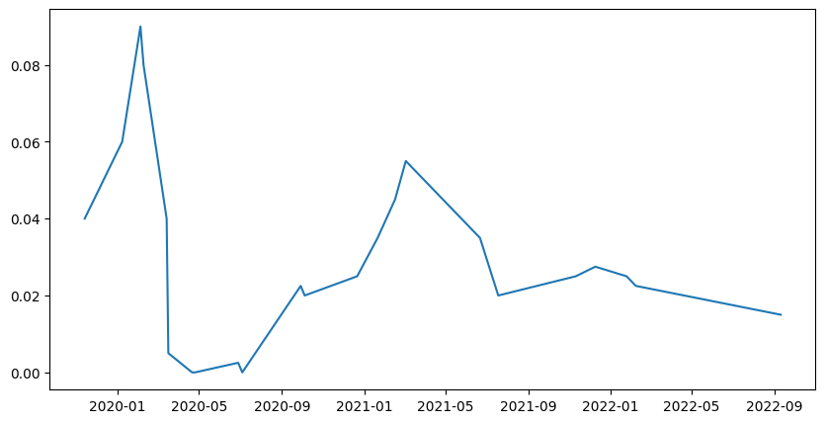
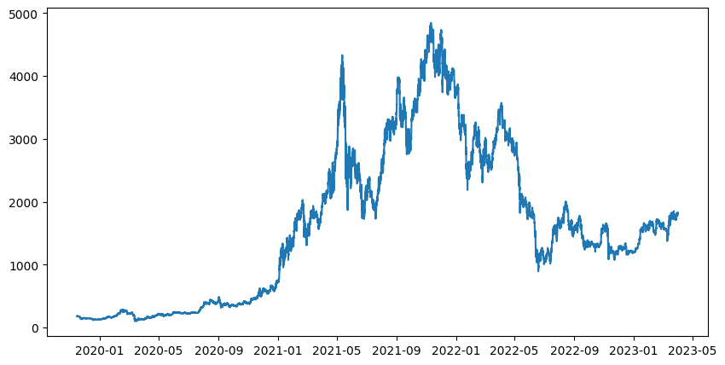
Results: Raw Data
Figure 1: Total number of each function name
Figure 2: The proportion of each collateral type
Figure 3: Stability fee rate per year
Figure 4: ETH/DAI rate

Slide 18
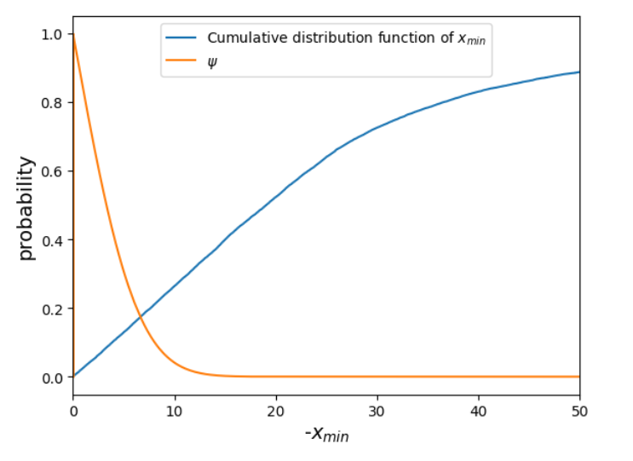
MakerDao for portfolio sold-out
Daily data
vec A borrowers with debt amounts.
K is a covariance for their defaults.

Slide 19
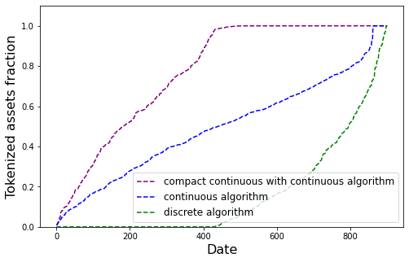
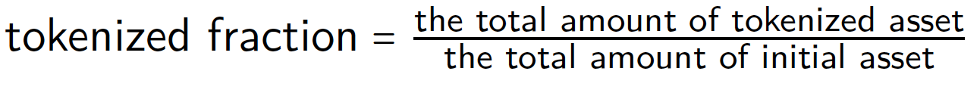
Baseline: MakerDAO dataset
The proportion of tokenized asset into the packages defines as
Table: The tokenized fractions of different models
Method | Tokenized fraction
Compact continuous with continuous algorithm * | 76.58 %
Special case continuous algorithm ** | 40.01 %
Special case discrete algorithm ** | 13.65 %
* Solved by the metaheuristics Slime Mould Algorithm (SMA)
** Mis-Model assumption: independent with the same variance.
The tokenized into commodity asset fractions
Notes:
The compact continuous with continuous algorithm, 77% of initial assets are tokenized and allocated into packages which is the highest tokenized fraction. Following by continuous and discrete algorithm.

Slide 20
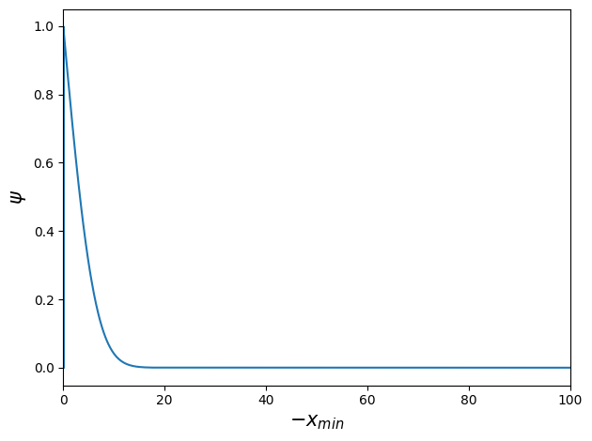
Results: Statistical Data
 | Statistical Data
Date | 13 Nov, 2019 - 31 Mar, 2023
Total users | 18,352
Total number of loan | 24,855
Total locked collateral | 851,494.17 ETH
Total generated debt | 353,840,942.42 DAI
The average daily loan | 4.68 loans
The mean time until default | 99.88 days
Table: MakerDao statistical data
Figure 5: Probability and level of default

Slide 21
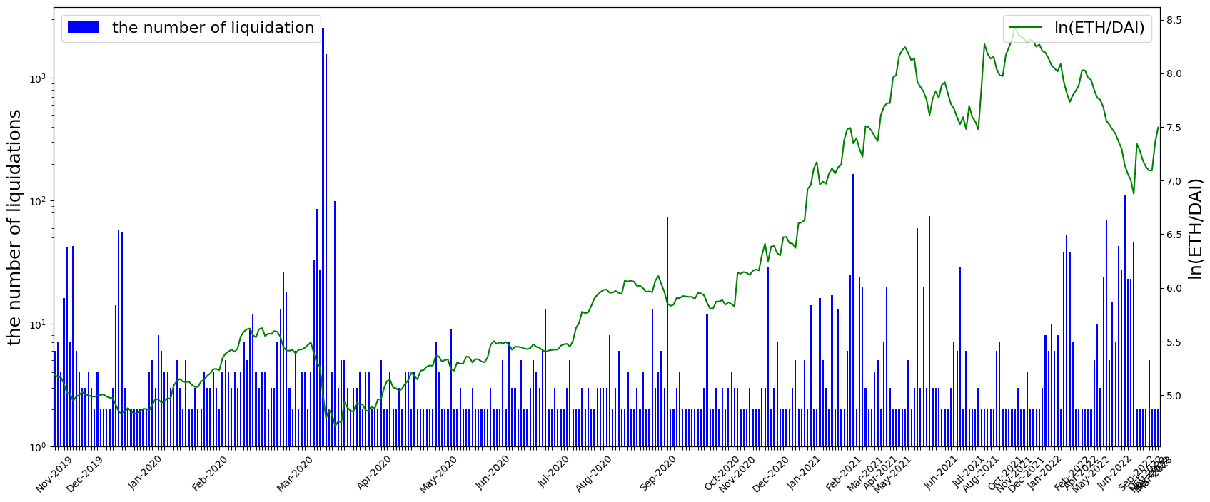
Results: liquidation and ETH/DAI rate
Figure 6: Total number of liquidations and natural logarithm of ETH/DAI rate

Slide 22
Discussion of results
Comparative critical analysis: what you have deduced from the findings and how these results relate to previous research or other studies.
Research limitations
NB! Focus on your personal contribution.

Slide 23
Scientific novelty
State-of-the-art component of your research project.
NB!
On this slide, you are supposed to highlight how your research project results stand out from similar studies. It can range from the demonstration of a well-established phenomenon in a new system to testing a hypothesis with no precedent in the literature.
Scientific novelty

Slide 24
Innovation
Innovation component of your research project (if any), i.e.:
Start-up potential
or
Industrial application of research results

Slide 25
Design and develop optimization method to obtain the optimal portfolio sold-out
01
Apply optimization method to the MakerDao dataset
02
Notes:
Phrases you may find useful:
All these results suggest that …
We can conclude that …
Taken together, these results point to three conclusions …
To sum up, …
Although it is still too early to draw a definite conclusion, it can be stated that …
Although the obtained data are limited, we may conclude that

Slide 26
Conclusions
Portfolio sold-out problem is reduced to SOCP, which allows optimal numerical solution.
MakerDao DeFi protocol provides real loan dataset, which is impossible for classic banking system.
SOCP solver will be applied to the MakerDao dataset
Notes:
Phrases you may find useful:
All these results suggest that …
We can conclude that …
Taken together, these results point to three conclusions …
To sum up, …
Although it is still too early to draw a definite conclusion, it can be stated that …
Although the obtained data are limited, we may conclude that

Slide 27
Outcomes
Papers
Talks
Conferences
Licenses/patents
Startups, etc.

Slide 28
Outlook: planning to achieve
To complete optimization part with solving SOCP.
Notes:
Phrases you may find useful:
The achieved results indicate that the work along the same line should proceed. Thus, the long-term results of the project are to …

Slide 29
Acknowledgements
List of colleagues who considerably contributed in the research.
Notes:
Phrases you may find useful:
I would like to express my gratitude to … who <provided smth /assisted in smth/ conducted smth/ etc.>
Thank you for your attention. Now I’m ready to answer your

